Slide 1

ENERGY CONSUMPTION
Matthew Miller

Slide 2
Data:
World Energy Consumption (Electric)
Coal Prices
Solar Prices
Emissions
Some questions:
What renewable energy sources are available as an alternative to traditional?
How have source distributions evolved over time?
What source generates the most carbon emissions?
How do prices affect energy consumption?

Slide 3
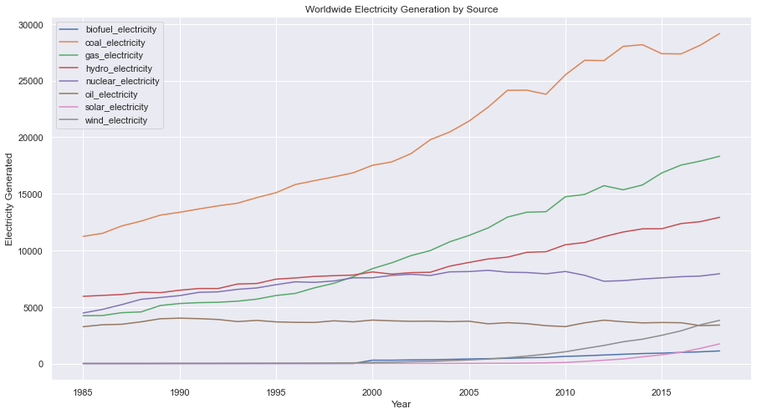
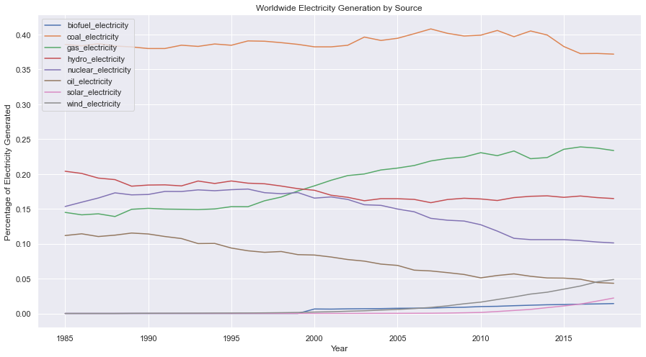
How much electricity is generated by each source worldwide?
How has their market share developed over time?
Notes:
Coal Electricity has maintained its level of market share
Gas and Renewables are gaining market share as nuclear, and oil are losing

Slide 4
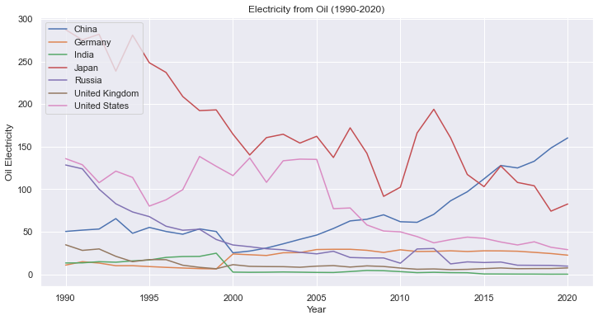
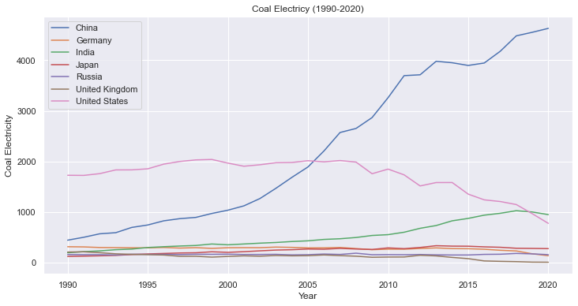
Traditional Coal and Oil
Notes:
Worldwide data is dominated by sharp increases in China’s energy consumption, especially in its increases in coal

Slide 5
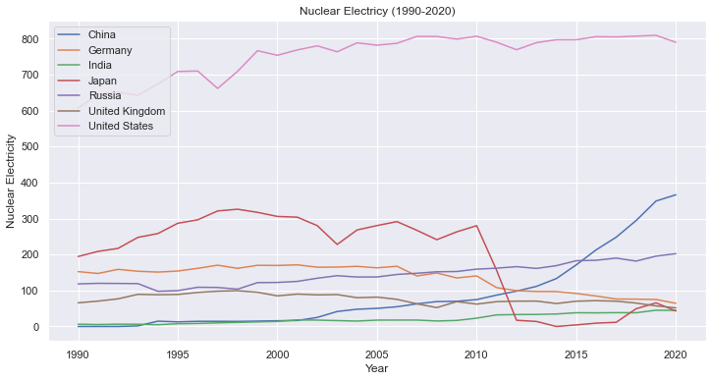
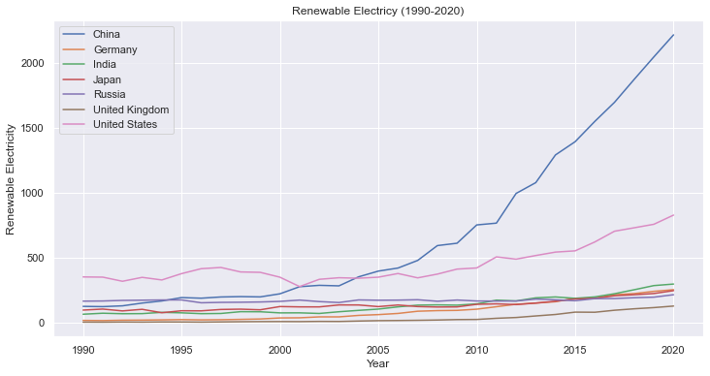
Renewables and Nuclear
What else does the data tell us?
Notes:
Japan lost large amounts of nuclear power production due to the catastrophe at Fukushima Daiichi Nuclear Power Plant disaster
Clearly China is outpacing the US in energy production
China is focused heavily on Renewables such as wind and solar while the US has maintained nuclear resources

Slide 6
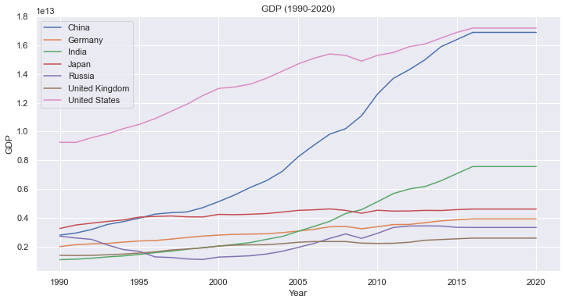
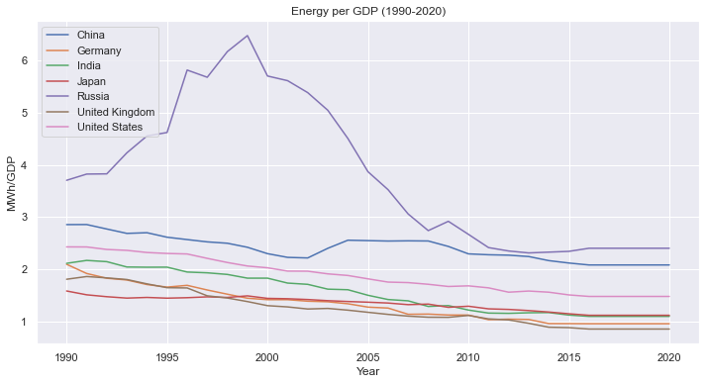
GDP and Energy Consumption
Why such a high energy to GDP ratio in Russia?
United States and China have the largest GDP’s
Notes:
Dissolution of the Soviet Union
Interesting to look specifically at those countries and their energy makeup

Slide 7
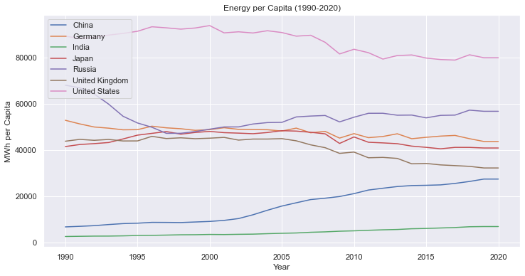
Energy and Populations
US citizens consume by far the most energy per person, but this has trended down as China rises in the last 20 years

Slide 8
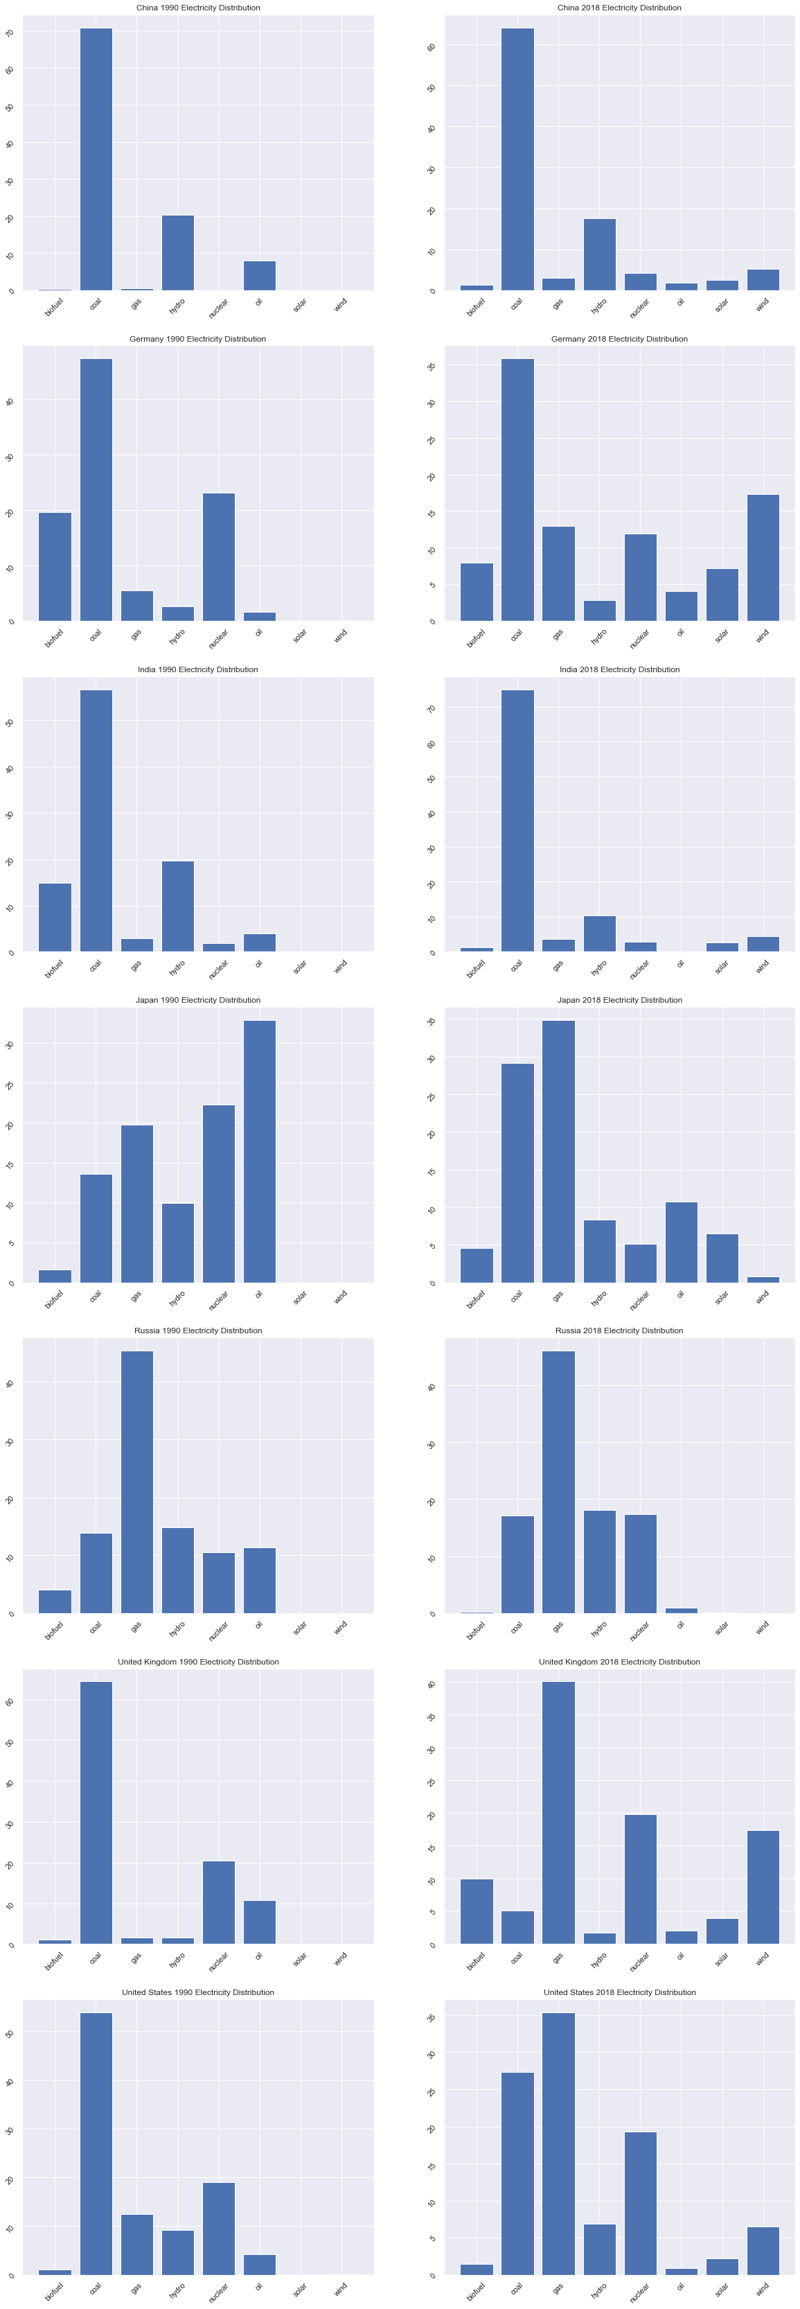
US Energy Distribution
Notes:
Distribution shows natural gas overtaking coal as primary source of electricity
Modern fracking began in the 1990’s and grew quickly and began to dominate market share in 2016
Shows growth in renewables
Renewables have more than doubled in market share since the early 90’s

Slide 9
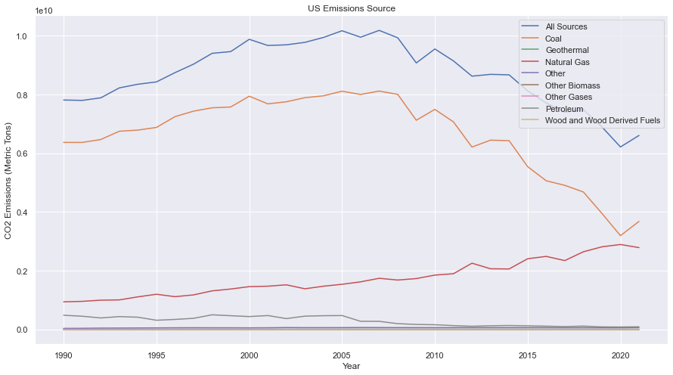
Emissions per Source
US Electric Sector CO2 emissions
Coal is clearly the greatest emitter of carbon
Notes:
Overall, we have begun to reduce the amount of carbon emissions in the US, however, not at a high enough pace
Considering natural gas has outpaced coal in recent years, we should first focus on eliminating coal as an energy source while making the transition to renewables/nuclear

Slide 10
How have other nations developed?

Slide 11
Germany Distribution

Slide 12
China Distribution

Slide 13
Japan Distribution

Slide 14
India Distribution

Slide 15
Russia Distribution

Slide 16
UK Distribution

Slide 17
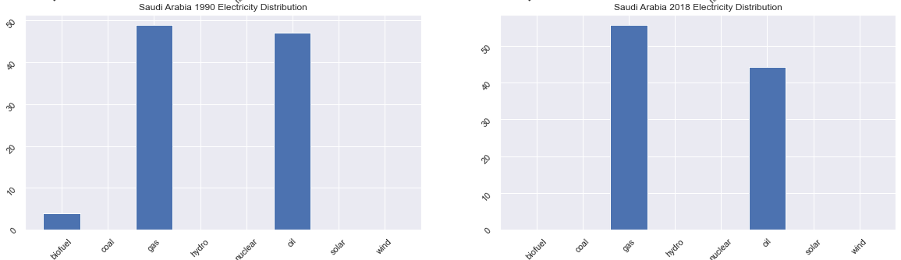
Saudi Arabia Distribution

Slide 18

What is the rate of change of renewable vs rate of change of carbon intensive sources?
Notes:
What sources are growing the fastest?

Slide 19
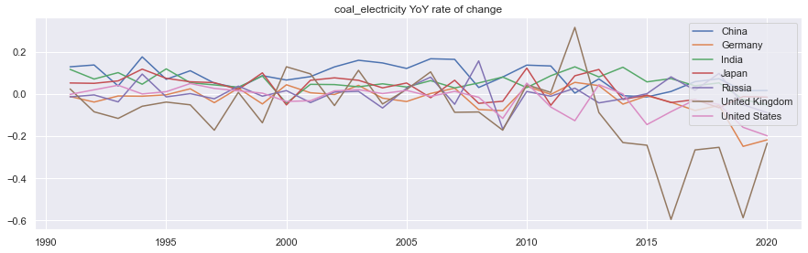
Coal Rate of Change
Notes:
Over the last decade, there is a clear loss of interest in coal outside of China and India

Slide 20
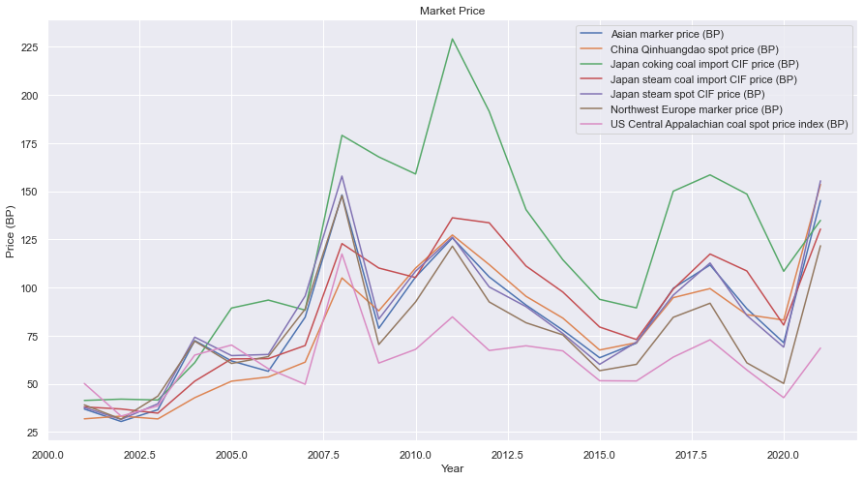
Coal Market Prices
Notes:
Major volatility and increases in price can be seen around the world in the coal markets over the last two decades, which may be impacting the transition

Slide 21
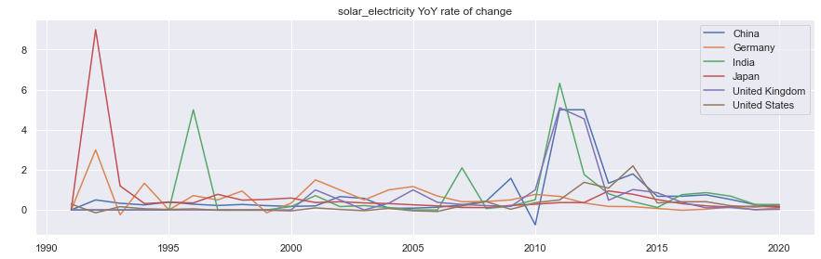
Solar Rate of Change
Notes:
Had to remove Russia, which also had a massive increase ~2012 in solar projects that came online
As I went through the year over year energy consumption by source, solar was clearly in the lead of the last 20 years for ramping up

Slide 22
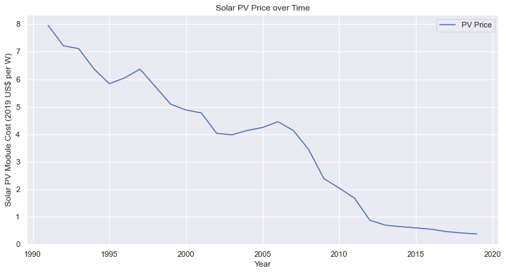
Why the investments in solar?
Notes:
Pay less than 20 cents per Watt nowadays, making it the cheapest energy source available
How did this happen?
US created the tech for modern day solar cells made of silicon, which is much more efficient
Germany created a market through policy in 2000
China made production cheap across the market, and now produce ~70% solar panels world wide

Slide 23


The Future
The energy transition is ahead of us
What will the energy distributions look like in a decade?
Sustainability Projects:
Inflation Reduction Act (USA)
The Line in Saudi Arabia
Telosa in the US desert
Notes:
Other things to explore if taking this project further?
How much CO2 in the atmosphere over the same years?
How has this affected the rate of CO2 emitted into the atmoshpere?
How does this growth compare to commitments made by countries at Paris Accord and elsewhere?
Points of influx - when did/will renewables become cheaper than traditional sources?
Why don’t we use more solar energy?
How could energy storage issues be solved?

Slide 24
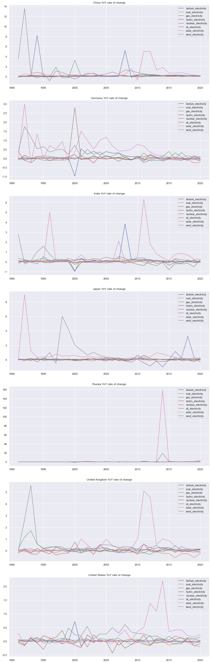

Slide 28
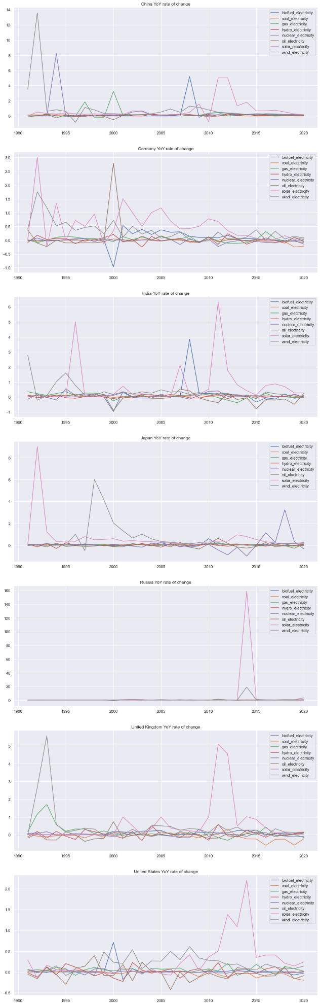

Slide 31
